Slide 1
1.Bash basics
Gayathri S Pramod

Slide 2
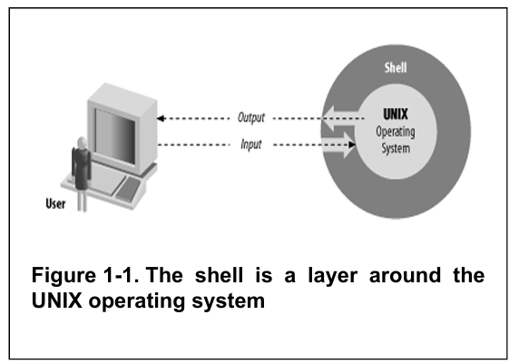
What is shell-Layman’s words
The shell translates our input for the OS to understand, and the OS uses the translated input to utilise the hardware to do the needful. The output from it is delivered back to the user via the shell.
SO SHELL IS A USER INTERFACE- How the user interacts with the system
Shell can be a Command line interface- BASH- uses characters to communicate with the OS as input and gives them back as output.(uses keyboard, mouse, monitor etc)
or Graphical User Interface- uses pictures, icons, etc (used in Windows, Android)
Shell is used to translate our commands to OS commands

Slide 3
HISTORY OF UNIX SHELLS
Bourne Shell- sh
Still popular and essentially unchanged, as many still use this UI
C Shell- csh
Named after the similarities with C Programming. Written as part of the Berkeley software version of UNIX
Korn Shell- ksh
More similar to bash. A commercial product incorporating the best of sh and csh with its features.
1979
UNIX Making its UI independent of OS.
Bourne shell was created under the GNU project, where creating a free software OS was the goal of the project. “COPYLEFT”-where software can be freely distributed as long as no restrictions are placed.

Slide 4
BASH-Features
The most popular Bourne shell derivative
Includes the best of Korn and C shell
Command Line Editing- The best feature of the Bash shell- allows editing previously run commands.
Job control gives the ability to stop, start and pause any number of commands simultaneously-helpful for the interactive uses

Slide 5
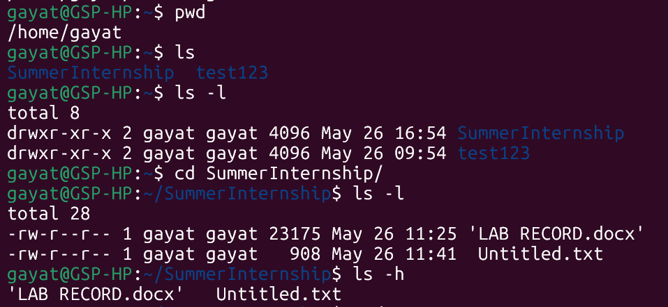
COMMANDS, ARGUMENTS AND OPTIONS
In simple terms,
Command- the 1st word of the line, that tells the shell to do something
Rest after the command- Arguments or parameters, which usually can be a file name, document- the things on which the command is applied.
Options- A special type of argument that gives the command specific information. ( like to make the list numerically ascending or descending, etc)
Here, ls is a command to show the list of files and folders and their info. pwd is another command to show the full path of your current location in the file system. –l after ls is an option which tells the command ls to list the files with all details. In the command cd SummerInternship, the latter term is the argument and cd being the command to change directory..

Slide 6
FILES- THE MOST IMPORTANT OG THR UNIX SYSTEM.
FILES
Regular files
Executable files
Directories
Can have any type of information.
Regular files: the text files that contain readable characters and
Texts.
Executable files: the program files that
Are executed or invoked as commands
Directories: Folders with other files; can have more subdirectories within one directory, making a tree or hierarchy.

Slide 7
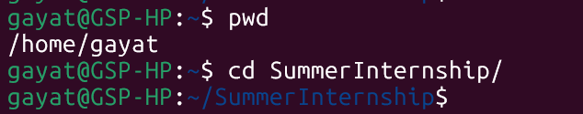
Pathnames and Working Directories
Pathnames give the exact pathway for a particular folder or file. They can be absolute, which gives the entire pathway to a particular file home or the root directory; or relative, which is relative to the current location.

Slide 8

Tilde Notation (~)
(~) is used as a shortcut for the home directory.
In the below example, the home directory is /home/gayat/ which is abbreviated using ~/. Typing this after the command cd, made to enter the given file test2705, which is a subdirectory inside the directory SummerInternship,

Slide 9

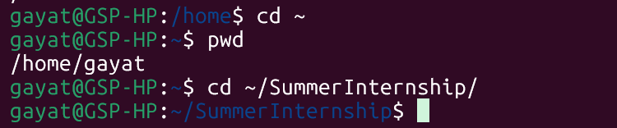
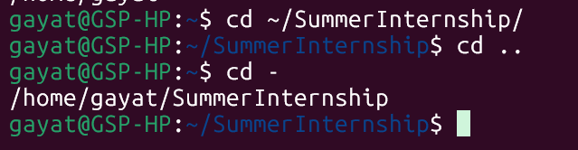
changing working directories
Other than the cd command and ~, there are many other commands to change the directories.
Using cd .. , you can go back to the parent directory of the current location.
Using cd -, you can go back to the file from which you returned to the parent file.

Slide 10
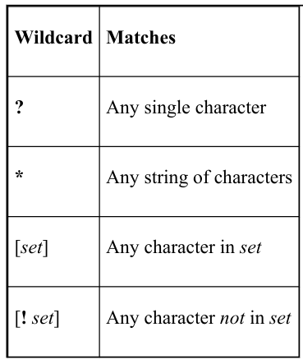
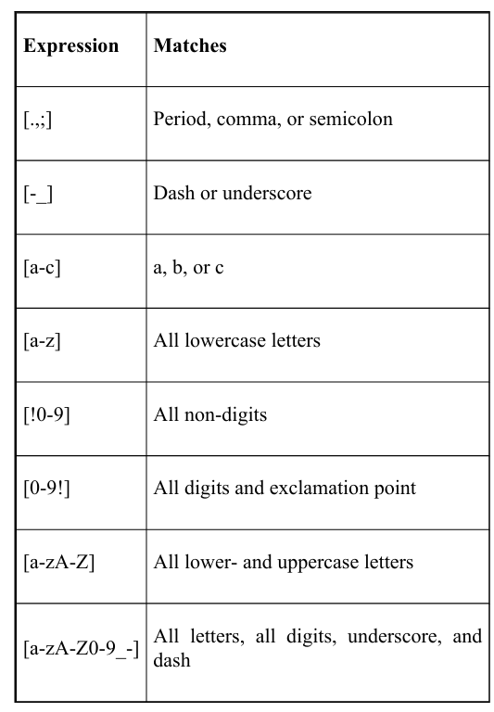
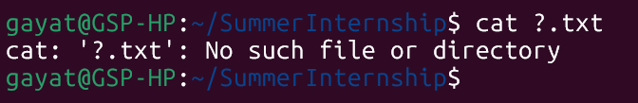
Filename, wildcards and pathname expansions
Like options to give specific information to the command, there are other ways to do the same.
One method is WILDCARDS- A built-in way to specify a pattern of a set of filenames without having to know or type them every time, using special characters.
If they don’t match the characters , they just remain untouched.
(Note: * means nothing too! So if you have files with names like ed, fred, dave, etc., then *e* will show ed and fred as the result.)
In the case of [!0-9], this stands to negate the set, so considering all non-digits (no numbers) So to place just !, [\!] is used.
The process of matching the expressions with wildcards to filenames- wildcard expansion or globbing!

Slide 11
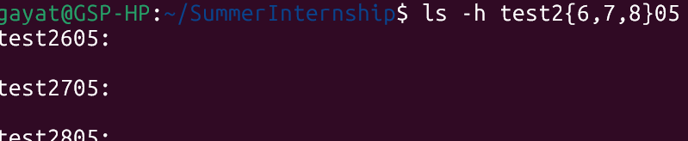
Brace expansion
Similar to pathname expansion, these are used to expand an arbitrary string of a given form.

Slide 12
INPUT AND OUTPUT
Based on 2 ideas- input is taken in as arbitrarily long sequences of characters, and everything that is created is considered a file.
Standard Input and Output
For accepting input→ only standard input
For producing output→ only standard output
For creating an error message→ standard error output

Slide 13
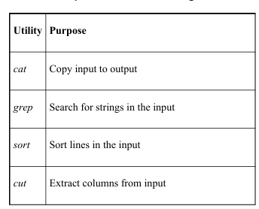
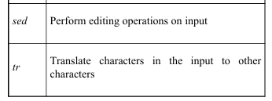
UNIX DATA FILTERING UTILITIES
The format of writing these commands:
Grep- grep (option) Pattern(i.e. what to search in the file) filename
Shows the thing you searched inside the file
Sort- sort (options) filename
Sorts the contents of the file in alphabetical order
Cat- cat filename
Shows the contents of the file
Cut- cut –c (number of characters after which need to be cut) filename
Cut all the characters after the nth character- includes space too.
Sed command- editing command
Substitution- sed ‘s/to be changed/changed to what/g’ filename
Deletion- sed ‘/word to be deleted/Id’ filename
Print the lines with a word specifically- sed ‘/word/p’ filename
Print only those lines- sed-n ‘/word/p’ filename
Tr command- to transliterate something to another
:tr set1 set2

Slide 14
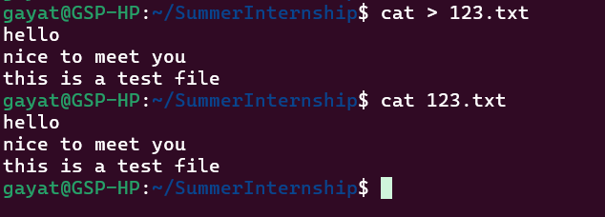

I/O REDIRECTION
Used to direct the input or output from a command to some other command or file.
Using >, you are redirecting the standard output to a file. So whatever you type in as standard output will be written to the file.
Using <, you are redirecting the standard input to be the contents of the file given. You don’t have to type the input, instead, the contents of the file become the input.

Slide 15
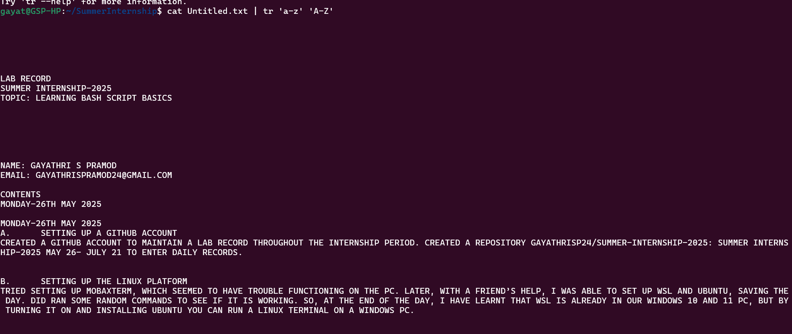
PIPELINES
Used when multiple files are connected; to redirect the output of 1 command to the input of another command.
Using the |, indicating that it is a ‘pipe.’
Enables to do more than one job at a time.

Slide 16
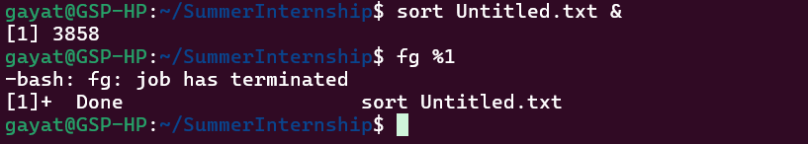
Background Jobs
Those jobs which takes long time to run, they can be enabled to work in the background.
The format being: sort filename &
Here, with the &, you make the sorting process a background job and since only one work was going on, it got priority 1 and the 3858 is the process ID. With fg %1, you brought the command foreground and it showed a completion message.

Slide 17
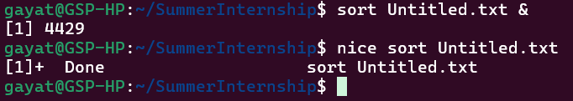
Background Job and priorities
Every job is assigned a priority with numbers, which tells the OS about the level of priority. The lower the number, the higher the priority.
The command ‘nice’ is used to lower the priority of the job and run/rerun the command.(You are asking the command to be nicer and not take too much CPU power!)
Here, you successfully ran sort in the background, and then you successfully ran sort again with a lower priority using nice. The [1]+ Done message just happened to appear when your previous background job completed.

Slide 18
Character | Meaning
~ | Home directory
 | Command (archaic) substitution
# | Comment
$ | Variable expression
& | Background job
* | String wildcard
( | Start subshell
) | End subshell
 | Quote next character
` | `
[ | Start character-set wildcard
] | End character-set wildcard
{ | Start command block
} | End command block
; | Shell command separator
 | Strong quote
 | Weak quote
< | Input redirect
> | Output redirect
/ | Pathname directory separator
? | Single-character wildcard
! | Pipeline logical NOT
Special Characters

Slide 19
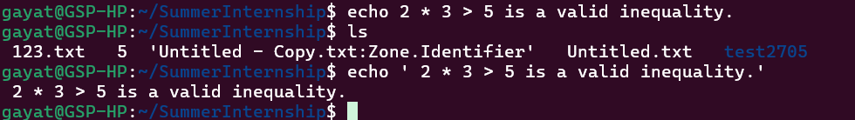
Quotations
To remove the special meaning of the characters.
As given below, the statement without quotations ended up creating a new file 5. but with quotations, it is printed back.

Slide 20
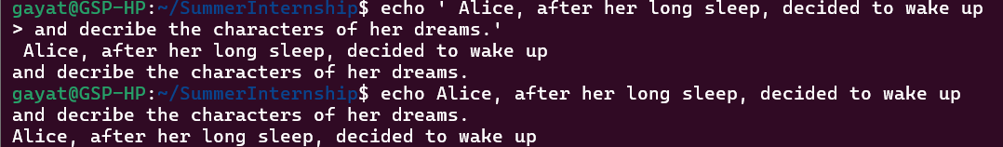
Continuing the lines
By quoting return or enter key, you can continue the command text beyond one line, using:
Ending the line with \
By not closing the quote.

Slide 21
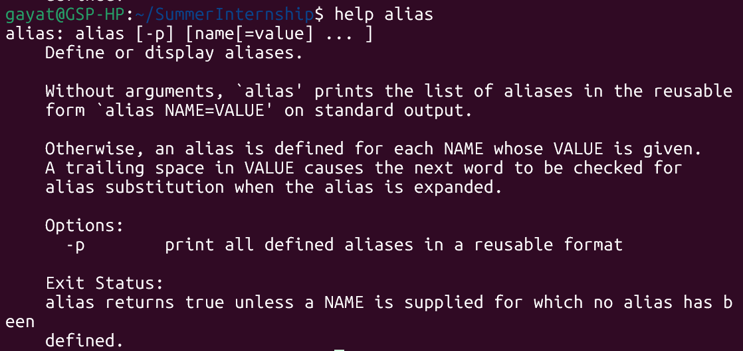
HELP
The help command gives information about the commands in bash
Format of help command is Help command name

Slide 22
THANK YOU

